Slide 1
Dimensionality Reduction and Principal Component Analysis

Slide 2
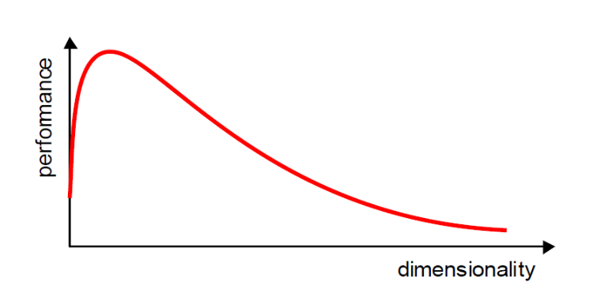
Curse of Dimensionality
Increasing the number of features will not always improve classification accuracy.
In practice, the inclusion of more features might actually lead to worse performance.

Slide 3
Dimensionality Reduction
What is the objective?
  Choose an optimum set of features of lower dimensionality to improve classification accuracy.
Different methods can be used to reduce dimensionality:
  Feature extraction
  Feature selection

Slide 4
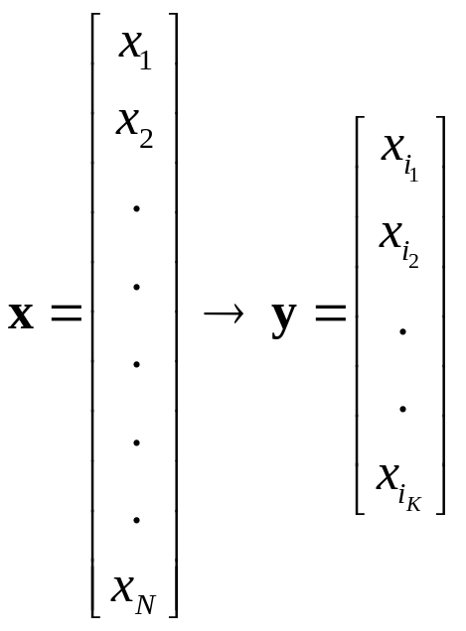
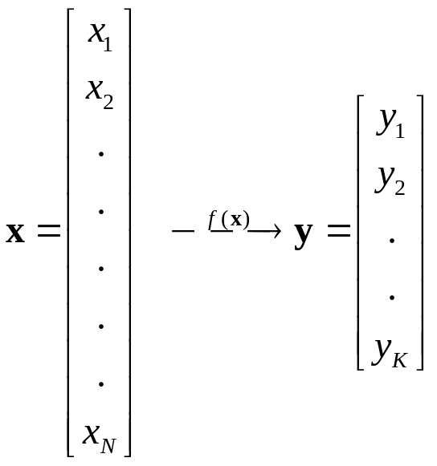
Dimensionality Reduction (cont’d)
  Feature extraction: finds a set of new features (i.e., through some mapping f()) from the existing features.
  Feature selection: chooses a subset of the original features.
The mapping f() could be linear or non-linear
K<<N
K<<N

Slide 5
Feature Extraction
Linear combinations are particularly attractive because they are simpler to compute and analytically tractable.
Given x ϵ R^{N}, find an K x N matrix T such that:
y = Tx ϵ R^{K} where K<<N
T
This is a projection from the N-dimensional space to a K-dimensional space.

Slide 6
Feature Extraction (cont’d)
Popular linear feature extraction methods:
  Principal Components Analysis (PCA): Seeks a projection that preserves as much information in the data as possible.
  Linear Discriminant Analysis (LDA): Seeks a projection that best discriminates the data.

Slide 7
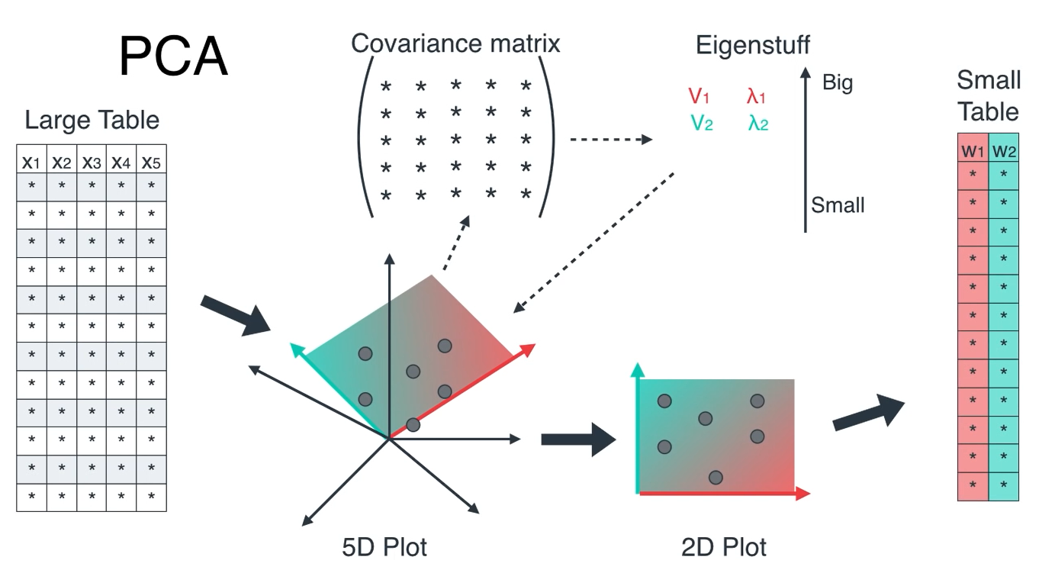
Principal Component Analysis (PCA)

Slide 8
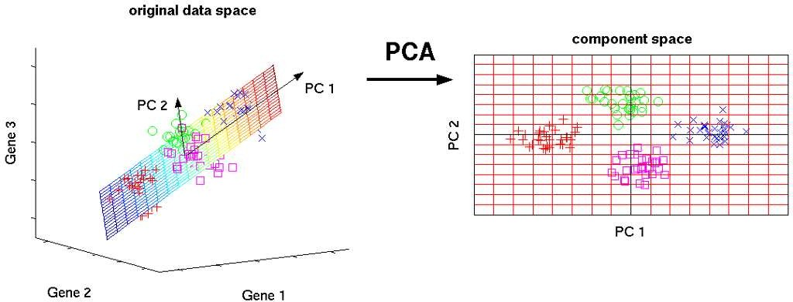
Principal Component Analysis
Principal Component Analysis (PCA):
It is a technique of
dimensionality reduction which performs the said task by reducing the higher-dimensional feature-space to a lower-dimensional feature-space. It also helps to make visualization of large dataset simple.

Slide 9
Principal Component Analysis
Some of the major facts about PCA are:
Principal components are new features that are constructed as a linear
combinations or mixtures of the initial feature set.
These combinations is performed in such a manner that all the newly constructed principal components are uncorrelated.
Together with reduction task, PCA also preserving as much information as possible of original data set.

Slide 10
Principal Component Analysis
Some of the major facts about PCA are:
Principal components are usually denoted by PCi, where i can be 0, 1, 2,
3,. ….,n (depending on the number of feature in original dataset).
The major proportion of information about original feature set can be alone explained by first principal component i.e. PC1.
The remaining information can be obtained from other principal components in a decreasing proportion as per increase in value of i.

Slide 11
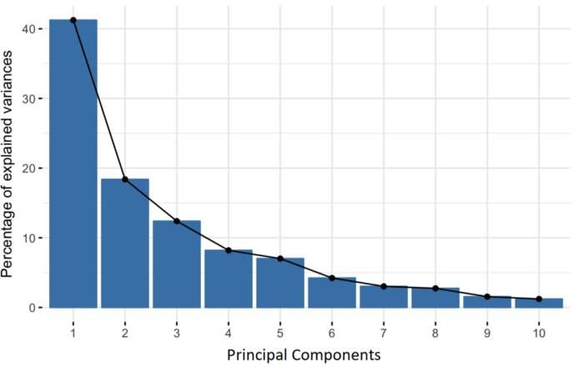
Principal Component Analysis

Slide 12
Principal Component Analysis
Geometrically , it can be said that principal components are lines pointing the directions that captures maximum amount of information about the data.
Principal components also aims to minimize the error between the true
location of the data points (in original feature space) and the projected location of the data points (in projected feature space).
The larger the variance carried by a line, the larger the dispersion of the data points along it, and the larger the dispersion along a line, the more the
information it has.
Simply, principal components are new axes to get better data visibility with clear difference in observations.

Slide 13
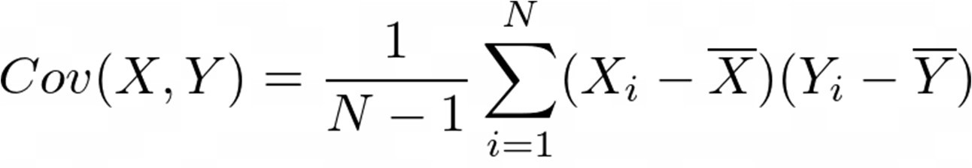
Principal Component Analysis
Stepwise working of PCA
Step 1: Construction of covariance matrix named as A.
The aim of this step is to understand how the variables of the input data set are varying from the mean with respect to each other, or in other words, to see if there is any relationship between them.
Step 2: Computation of eigenvalues for covariance matrix.
The eigenvectors of the Covariance matrix are actually the directions of the axes where there is the most variance (most information) and that we call Principal Components

Slide 14



Principal Component Analysis
Stepwise working of PCA
Step 3: Compute eigenvectors corresponding to every eigenvalue obtained in step 2
The eigenvalues are simply the coefficients attached to eigenvectors, which give the amount of variance carried in each Principal Component.
Step 4: Sort the eigenvectors in decreasing order of eigenvalues and choose k eigenvectors with the largest eigenvalues.
Step 5: Transform the data along the principal component axis.

Slide 15

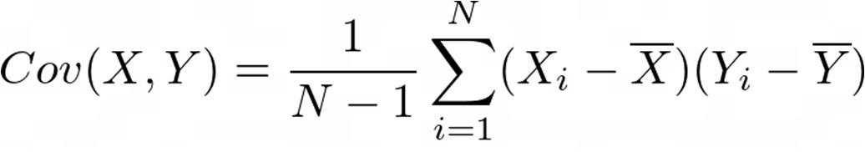
Principal Component Analysis-Example
Example:
Compute Covariance Matrix i.e. A
X | Y
2.5 | 2.4
0.5 | 0.7
2.2 | 2.9
1.9 | 2.2
3.1 | 3
2.3 | 2.7
2 | 1.6
1 | 1.1
1.5 | 1.6
1.1 | 0.9
Cov(X,X) | Cov(X,Y)
Cov(Y,X) | Cov(Y,Y)
Original dataset

Slide 16

Principal Component Analysis-Example
Example:
X | Y | 𝑋_{i} − 𝑋¯ | (𝑌_{i} − 𝑌¯) | (𝑋_{i}−𝑋¯)(𝑋_{i} − 𝑋¯) | (𝑌_{i}−𝑌¯)(𝑌_{i} − 𝑌¯) | (𝑋_{i}−𝑋¯)(𝑌_{i} − 𝑌¯)
2.5 | 2.4 | 0.69 | 0.49 | 0.4761 | 0.2401 | 0.3381
0.5 | 0.7 | -1.31 | -1.21 | 1.7161 | 1.4641 | 1.5851
2.2 | 2.9 | 0.39 | 0.99 | 0.1521 | 0.9801 | 0.3861
1.9 | 2.2 | 0.09 | 0.29 | 0.0081 | 0.0841 | 0.0261
3.1 | 3 | 1.29 | 1.09 | 1.6641 | 1.1881 | 1.4061
2.3 | 2.7 | 0.49 | 0.79 | 0.2401 | 0.6241 | 0.3871
2 | 1.6 | 0.19 | -0.31 | 0.0361 | 0.0961 | -0.0589
1 | 1.1 | -0.81 | -0.81 | 0.6561 | 0.6561 | 0.6561
1.5 | 1.6 | -0.31 | -0.31 | 0.0961 | 0.0961 | 0.0961
1.1 | 0.9 | -0.71 | -1.01 | 0.5041 | 1.0201 | 0.7171
=1.81
Cov(X,X)
= 0.6165
Cov(Y,Y)
= 0.7165
Cov(X,Y)= Cov(Y,X)
= 0.6154

Slide 17


Principal Component Analysis-Example
Example:
Compute eigenvalues
0.6165 | 0.6154
0.6154 | 0.7165
0.6165 | 0.6154
0.6154 | 0.7165
1 | 0
0 | 1
Find determinate by equating to zero
0.6165-𝜆 | 0.6154
0.6154 | 0.7165-𝜆
1
2

Slide 18




Principal Component Analysis-Example
Example:
-0.6675 | 0.6154
0.6154 | -0.5675
1
0.6165-𝜆₁ | 0.6154
0.6154 | 0.7165-𝜆₁
𝑥₁
O
𝑥₂
Compute eigenvectors
0.6165-𝜆₂ | 0.6154
0.6154 | 0.7165-𝜆₂
1
0.5674 | 0.6154
0.6154 | 0.6674
2
𝑥₁
2
𝑥₂

Slide 19
Principal Component Analysis-Example
Example:
0.67787
-0.73517
1
0.73517
2
0.67787
First Principal Component (PC1)
Second Principal Component (PC2)
“vector corresponding to highest eigenvalue of considered as PC1 followed by other component as per their eigenvalue.”
To calculate the percentage of information explained by PC1 and PC2, divide each component by sum of eigenvalues
PC1 = 96%
PC2 = 4%

Slide 20











Principal Component Analysis-Example
Step 4 helps to reduce the dimension by discarding the components with very less percentage of information in a multi-dimentional space. The remaining ones form a matrix of vector known as feature vector. Each column correspond to one principal component.
Step 5 data transformation along principal component using
T
T
in the new
feature space)

Slide 21
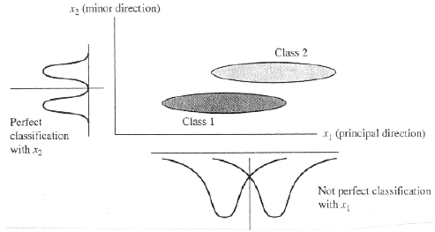
Limitations (cont’d)
PCA is not always an optimal dimensionality-reduction technique for classification purposes.

